Slide 1
Predict Arabic Dialect
Presented By: Hend Labib

Slide 2
Architecture
Data Fetching
Data Preprocessing
Features extraction
Model training
Evaluation of model

Slide 3
Data Fetching & Preprocessing
Data fetching :
Calling API by a POST request to retrieve text.
For loop to iterate all records , Because the size of the list must NOT exceed 1000.
Data Preprocessing:
Used regex instruction to keep Arabic and numeric chars and remove the rest.
Merge dataset (Before and after data fetching)
Remove unnecessary col
Check null values , duplicates

Slide 4
Features extraction
Convert a collection of raw documents to a matrix of TF-IDF features by using TfidfVectorizer

Slide 5
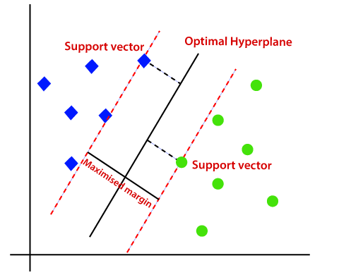
Model Training
Machine Learning Model (Linear svm):
Linear SVM is the newest extremely fast machine learning
(data mining) algorithm for solving multiclass
classification problems .
Deep Learning Model (MABERT):
MARBERT is a large scale pre-training masked language model focused on both Dialectal Arabic (DA) and MSA. Arabic has multiple varieties.

Slide 6
Evaluation of model
Macro_f1
Macro_f1_pos_neg
Macro_precision
Macro_recall
Acc (accuracy)

Slide 7
Results

